Slide 1
Face Alignment at 3000 FPS via Regressing Local Binary Features
Shaoqing Ren, Xudong Cao,
Yichen Wei, and Jian Sun
Visual Computing Group
Microsoft Research Asia

Slide 2
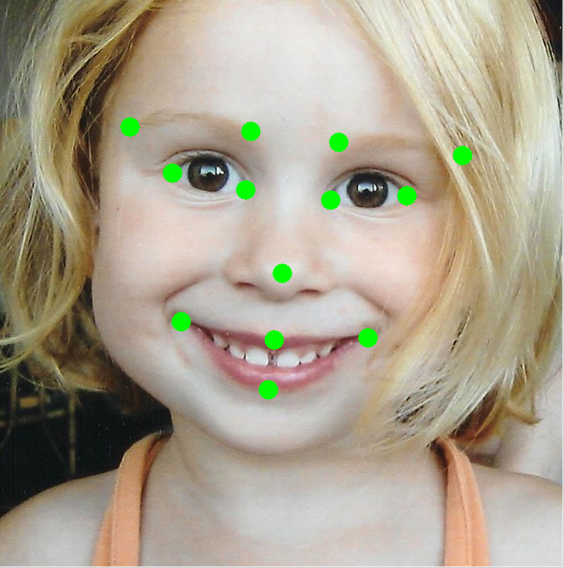
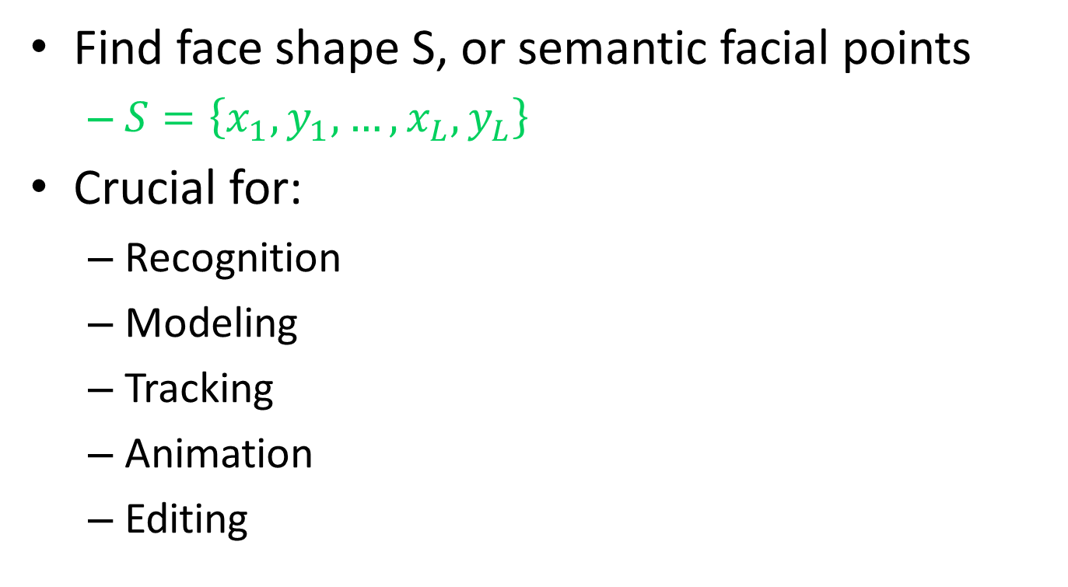
What is Face Alignment?
Find face shape S, or semantic facial points
$S=\left\{x_{1},y_{1},…,x_{L},y_{L}\right\}$
Crucial for:
Recognition
Modeling
Tracking
Animation
Editing

Slide 3

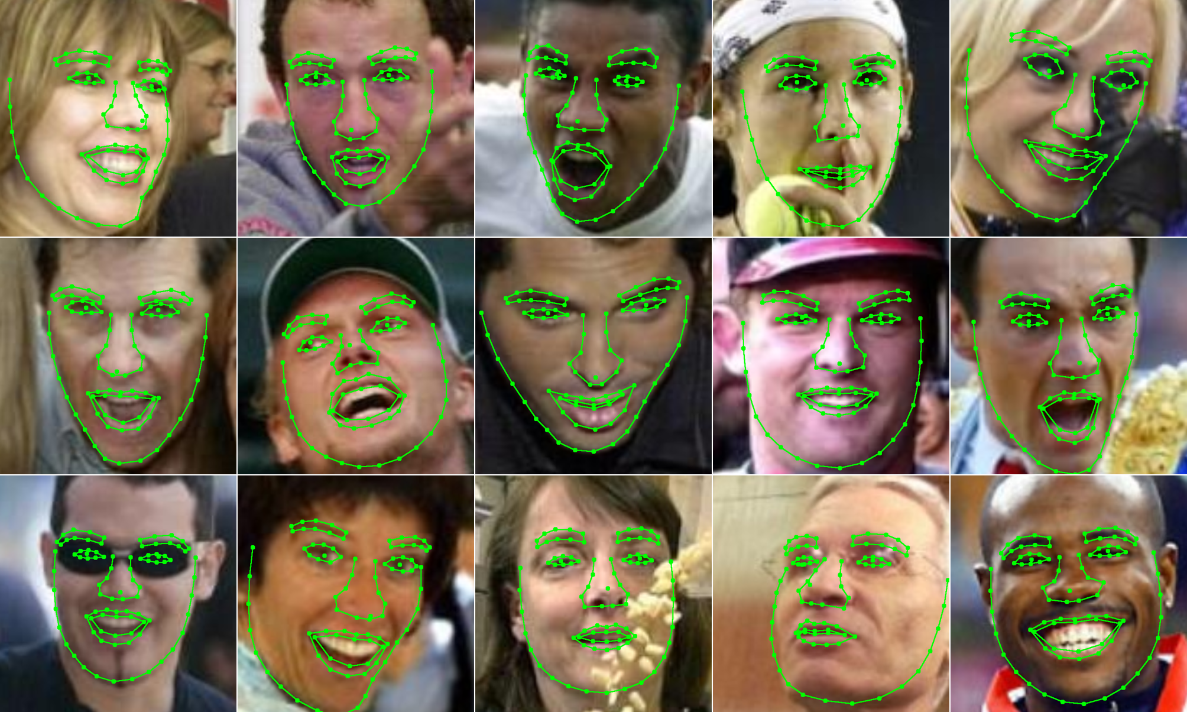



Challenges
Accuracy: robust to
complex variations
Speed: critical for
phone/tablet
system API
pose
expression
lighting
occlusion

Slide 4
Traditional Approaches
Active Shape Model (ASM)
detect points from local features
sensitive to noise
Active Appearance Model (AAM)
sensitive to initialization
fragile to appearance change
Regression based
[Cootes et. al. 1992]
[Milborrow et. al. 2008]
…
[Cootes et. al. 1998]
[Matthews et. al. 2004]
...
[Saragih et. al. 2007] (AAM)
[Sauer et. al. 2011] (AAM)
[Cristinacce et. al. 2007] (ASM)

Slide 5




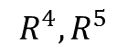
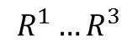
Cascade Shape Regression Framework
Stage t = 0
t = 3
t = 5
$$R^{1}…R^{3}$$
$$R^{4},R^{5}$$
$$S^{t}=S^{t−1}+R^{t}(I, S^{t−1})$$
Cascaded pose regression, Dollar et. al., CVPR 2010
Regressor $R^{t}\left(I, S^{t−1}\right)$ is learnt to minimize the shape residual on training data
$$R^{t}=\underset{R}{argmin}{\sum_{i}{\left|∆\hat{S_{i}}−R\left(I_{i},S_{i}^{t−1}\right)\right|}}$$
$∆\hat{S}=\hat{S}−S^{t−1}$: ground truth shape residual

Slide 6





Analysis of Previous Methods
Explicit shape regression, Cao et. al., CVPR 2012
Robust Cascade Regression, Burgos et.al., ICCV 2013
Supervised Descent Method, Xiong and Torre, CVPR 2013
Learning method
Boosted regression trees
local optimization
Linear regression
global optimization
$$X$$
$$√$$
Feature
Pixel difference
fast
learned from data
too weak for the hard problem
SIFT on landmarks
slow
hand crafted
$$√$$
$$X$$
$$√$$
$$X$$
$$X$$

Slide 7
Overview of Our Approach
Tree Induced Local Binary Features
learned from data
global optimization
much stronger than previous regression trees
efficient training / testing
Best accuracy on challenging benchmarks
3,000 FPS on desktop, or 300 FPS on mobile
first face tracking method on mobile

Slide 8
Tracking in Real World Videos
https://www.youtube.com/watch?v=TOVFOYrXdIQ
Face tracking = per-frame alignment + classification

Slide 9
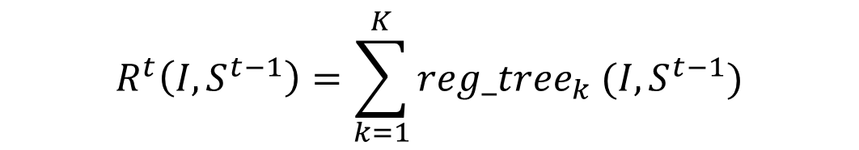
Our Approach
A simple form
sum of a large number of regression trees
Novel two step learning
Local learning of tree structure
learn an easier task and better features
Global optimization of tree output
enforce dependence between points and reduce local estimation errors
$$R^{t}\left(I,S^{t−1}\right)=\sum_{k=1}^{K}{{reg_tree}_{k} (I,S^{t−1})}$$

Slide 10















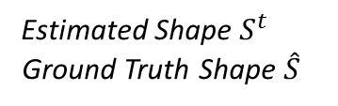
Local Learning of Tree Structure
Estimated Shape $S^{t}$
Ground Truth Shape $\hat{S}$
Random forest
Target: one point
…
…
learn standard random forests for each local point
standard regression tree using pixel difference features
only use pixels in the local patch around the point
regularization of feature selection

Slide 11



Adaptive Local Region Size
Shrink local region size during cascade regression learning

Slide 12
From Local to Global
Estimated Shape $S^{t}$
Ground Truth Shape $\hat{S}$
Random forest
Target: one point
…
…
Fix tree structures and optimize tree leave’s output

Slide 13
Global Optimization of Tree Output
Estimated Shape $S^{t}$
Ground Truth Shape $\hat{S}$
Feature Mapping Function
Regression Target
…
…

Slide 14

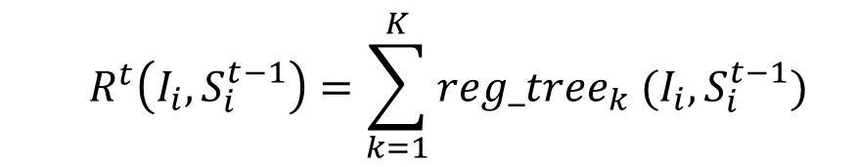

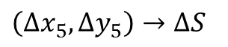
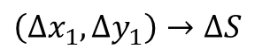

Global Optimization of Tree Output
$$\left(Δx_{1},Δy_{1}\right)→ΔS$$
$$\left(Δx_{5},Δy_{5}\right)→ΔS$$
point offset
$$→$$
face shape increment
optimize all leaves simultaneously by minimizing
$$\underset{R}{argmin}{\sum_{i}{\left|∆\hat{S_{i}}−R^{t}\left(I_{i},S_{i}^{t−1}\right)\right|}}$$
is linear to $R^{t}$
$$R^{t}\left(I_{i},S_{i}^{t−1}\right)=\sum_{k=1}^{K}{{reg_tree}_{k} (I_{i},S_{i}^{t−1})}$$
is linear to unknowns
Simply linear regression and global optimal solution!

Slide 15
Tree Induced Binary Features
Each leave is a binary indicator function
1 if the image sample arrives at the leaf
0 otherwise
Trees -> high dimension sparse binary features
Efficient training using linear SVM
Efficient testing by adding N leaves
N: number of trees, usually a few hundreds

Slide 16
Experiments
Benchmark | #landmarks | #training images | #testing images
LFPW | 29 | 717 | 249
Helen | 194 | 2000 | 330
300-W | 68 | 3149 | 689
Two variants of our method
Accurate: LBF 1200 trees with depth 7
Fast: LBF fast 300 trees with depth 5

Slide 17
Comparison with other methods
Cascade shape regression methods
Explicit Shape Regression (ESR) [2]
Robust Cascade Pose Regression (PCPR) [3]
Supervised Descent Method (SDM) [4]
Other methods
Exemplar based methods [1, 5]
AAM or ASM based methods [6, 7]
[1] P. N. Belhumeur, D. W. Jacobs, D. J. Kriegman, and N. Kumar. Localizing parts of faces using a consensus of exemplars (CVPR11)
[2] X. Cao, Y. Wei, F. Wen, and J. Sun. Face Alignment by Explicit Shape Regression (CVPR12)
[3] X. P. Burgos-Artizzu, P. Perona, and P. Dollar. Robust face landmark estimation under occlusion (ICCV13)
[4] X. Xiong and F. De la Torre. Supervised descent method and its applications to face alignment (CVPR13)
[5] F. Zhou, J. Brandt, and Z. Lin. Exemplar-based Graph Matching for Robust Facial Landmark Localization (ICCV13)
[6] S. Milborrow and F. Nicolls. Locating facial features with an extended active shape model (ECCV08)
[7] V. Le, J. Brandt, Z. Lin, L. Bourdev, and T. S. Huang. Interactive Facial Feature Localization (ECCV12)

Slide 18
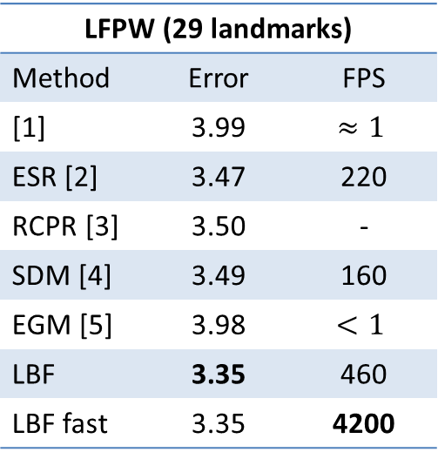
LFPW (29 landmarks)
Method | Error | FPS
[1] | 3.99 | $$≈1$$
ESR [2] | 3.47 | 220
RCPR [3] | 3.50 | -
SDM [4] | 3.49 | 160
EGM [5] | 3.98 | $$<1$$
LBF | 3.35 | 460
LBF fast | 3.35 | 4200
Helen (194 landmarks)
Method | Error | FPS
STASM [6] | 11.1 | -
CompASM [7] | 9.10 | -
ESR [2] | 5.70 | 70
PCPR [3] | 6.50 | -
SDM [4] | 5.85 | 21
LBF | 5.41 | 200
LBF fast | 5.80 | 1500
300-W (68 landmarks)
Method | Fullset | Common Subset | Challenging Subset | FPS
ESR [2] | 7.58 | 5.28 | 17.00 | 120
SDM [4] | 7.52 | 5.60 | 15.40 | 70
LBF | 6.32 | 4.95 | 11.98 | 320
LBF fast | 7.37 | 5.38 | 15.50 | 3100
LBF is much more accurate and a few times faster
LBF fast is slightly more accurate and dozens of times faster

Slide 19
Local Learning > Global Learning
Global Feature Learning : using the whole face region
Local Feature Learning : using the local patch (our method)

Slide 20
Binary Feature is Effective
Local Forest Regression: use local random forest’s output as features for global linear regression
Tree Induced Binary Features : our method

Slide 21
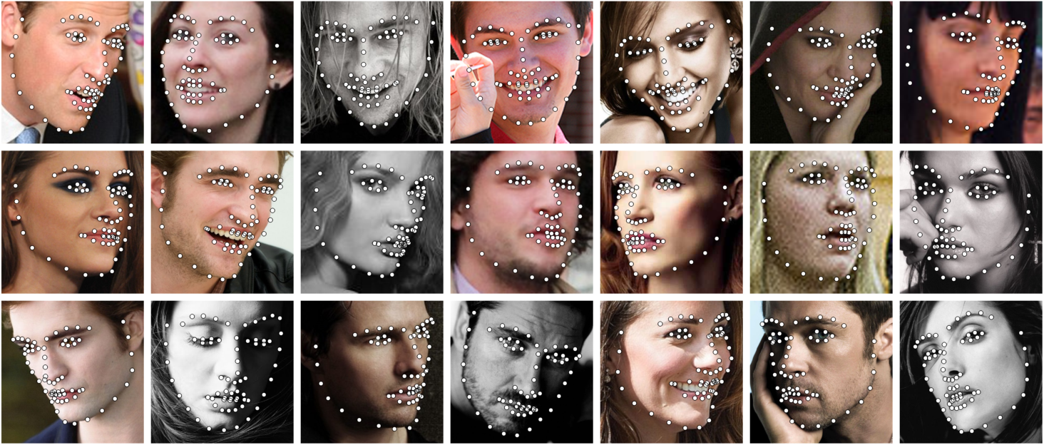
Examples

Slide 22
Summary
State-of-the-art face alignment
Best accuracy on challenging benchmarks
Dozens of times faster than previous methods
faster than real time face tracking on mobile
Thank you! Welcome to try our live demo!

